Slide 1


M.Tech Program
Advanced Industry Integrated Programs
Jointly offered by University and LTIMindTree
Review II
PROCURE BOT – Intelligent Procurement and Vendor Quality Assurance Assistant
Team Member
S Syed ali Fathima
Crescent 2025-27
Knowledge partner | Implementation partner

Slide 2
Project Title - Calibri body 18
Introduction
Procurement is a critical business function responsible for sourcing raw materials, components, products, and services from suppliers.
Procurement information is often distributed across purchase orders, vendor records, quotations, invoices, contracts, and policy documents.
Manual information retrieval and vendor evaluation can be time-consuming and may delay procurement decisions.
Vendor quality assurance requires continuous monitoring of supplier delivery performance, defective units, compliance, pricing, and historical performance.
Procure Bot is proposed as an AI-powered RAG-based assistant that enables natural-language procurement queries and provides data-driven insights for vendor evaluation and procurement decision support.

Slide 3
Project Title - Calibri body 18
Objective
To develop an AI-powered travel planning assistant for personalized tourism recommendations.
To understand user preferences including budget, travel duration, destination, and interests.
To retrieve relevant travel information using Retrieval-Augmented Generation (RAG). generate intelligent and personalized travel itineraries using Large Language Models.
To dynamically update travel schedules based on weather changes, transportation delays, and attraction availability.
To provide an interactive dashboard for seamless travel planning and management.

Slide 4
Project Title - Calibri body 18
Module name
Data Ingestion & Preprocessing
  Collects procurement data and cleans, transforms, and standardizes it for further processing.
Document Processing
  Converts procurement records into structured documents that can be processed by the AI system.
Embedding Generation
  Converts procurement documents into numerical vector representations using the Nomic Embed Text model.
Vector Database & Retrieval
  Stores embeddings in Qdrant and retrieves relevant procurement records based on user queries.

Slide 5
Module name
Query Routing
  Determines whether a user query requires RAG retrieval or procurement analytics/quality analysis.
Procurement Quality Analysis
  Calculates defect rates and identifies quality-related issues at both PO and supplier levels.
Supplier Performance Analysis
  Analyzes supplier performance using orders, defective units, defect rates, procurement value, and savings.
Compliance Analysis
  Analyzes procurement compliance and provides compliant, non-compliant, and overall compliance statistics.

Slide 6
Project Title - Calibri body 18
Methodology
Data Collection – Collect procurement and supplier records.
Data Preprocessing – Clean, standardize, and transform the collected data.
Document Creation – Convert procurement records into structured documents.
Embedding Generation – Generate vector embeddings using Nomic Embed Text.
Vector Storage – Store embeddings and metadata in Qdrant.
Query Processing – Accept and process user queries in natural language.
Query Routing – Route queries to either RAG retrieval or analytics modules.
Information Retrieval – Retrieve relevant procurement information using exact matching or semantic search.
AI Response Generation – Use Llama 3.1 to generate context-based responses.
Quality Analysis – Analyze defective units, defect rates, and procurement quality.

Slide 7
Methodology
Supplier Analysis – Evaluate supplier performance using procurement and quality metrics.
Compliance Analysis – Calculate compliance statistics and identify non-compliant orders.
Procurement Analytics – Calculate total value, savings, orders, and other KPIs.
API Integration – Connect backend modules using FastAPI.
Dashboard Development – Present results through an interactive React and Tailwind CSS dashboard.
Testing & Validation – Test retrieval, AI responses, analytics, APIs, and dashboard functionality.

Slide 8
Project Title - Calibri body 18
Data preprocessing & EDA
Data Cleaning – Remove duplicate and inconsistent procurement records.
Missing Value Handling – Identify and handle missing values in quantity, price, delivery, and defect-related fields.
Data Transformation – Standardize dates, numerical values, supplier names, and procurement categories.
Feature Engineering – Calculate metrics such as total procurement value, negotiation savings, and defect rate.
Exploratory Data Analysis (EDA) – Analyze procurement patterns, supplier performance, order status, defect rates, savings, and compliance.
Statistical Analysis – Generate summary statistics to identify trends and variations in procurement data.
Visualization – Use charts and graphs to understand supplier quality, procurement value, savings, and compliance patterns.

Slide 9
Project Title - Calibri body 18
Approach:
Data Preprocessing & EDA – Clean, transform, and analyze procurement data using Pandas and NumPy.
RAG-Based Approach – Retrieve relevant procurement information and generate context-aware answers using LlamaIndex and Llama 3.1.
Embedding & Semantic Search – Generate document embeddings using Nomic Embed Text and perform vector-based retrieval using Qdrant.
Query Routing & Analytics – Route user queries to RAG or analytical modules and calculate procurement, quality, supplier, and compliance metrics using Python.
Backend API Development – Integrate AI and analytics modules through FastAPI REST APIs.
Interactive Dashboard – Visualize procurement insights and provide an AI assistant interface using React.js and Tailwind CSS.

Slide 10
Project Title - Calibri body 18
Project plan
Requirement Analysis – Procurement requirements and project objectives identified.
Data Collection & Preprocessing – Procurement dataset cleaned, transformed, and analyzed using EDA.
RAG & Vector Database Development – Document processing, embeddings, Qdrant storage, and retrieval implemented.
AI & Analytics Module Development – Llama 3.1 integration, query routing, quality, supplier, and compliance analysis completed.
Backend Development – FastAPI APIs developed and connected with AI and analytics modules.
Frontend & Dashboard Development – React + Tailwind CSS interface developed; dashboard and AI Assistant integration in progress.

Slide 11
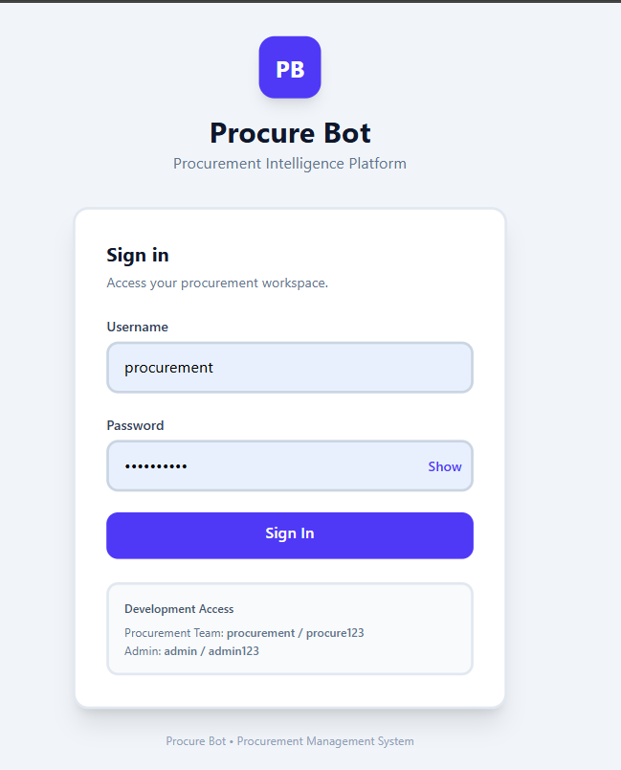
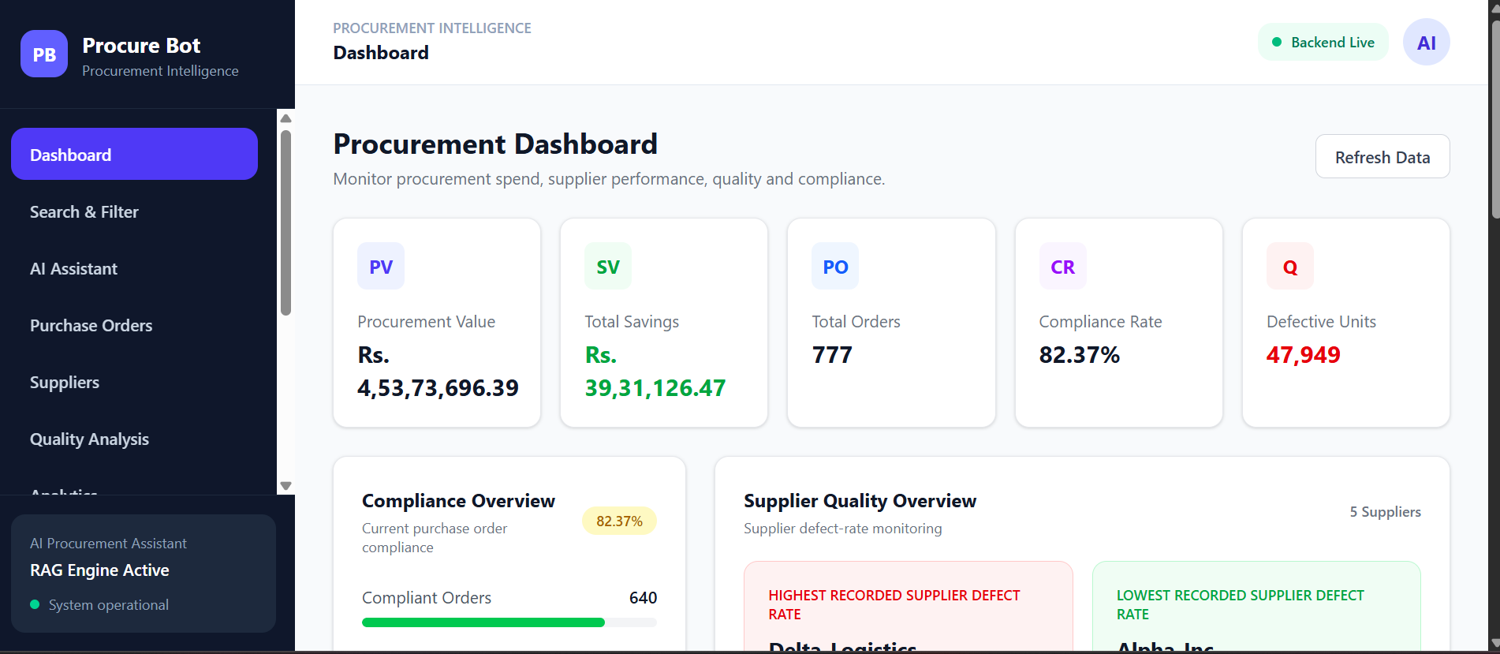
RESULT:

Slide 12
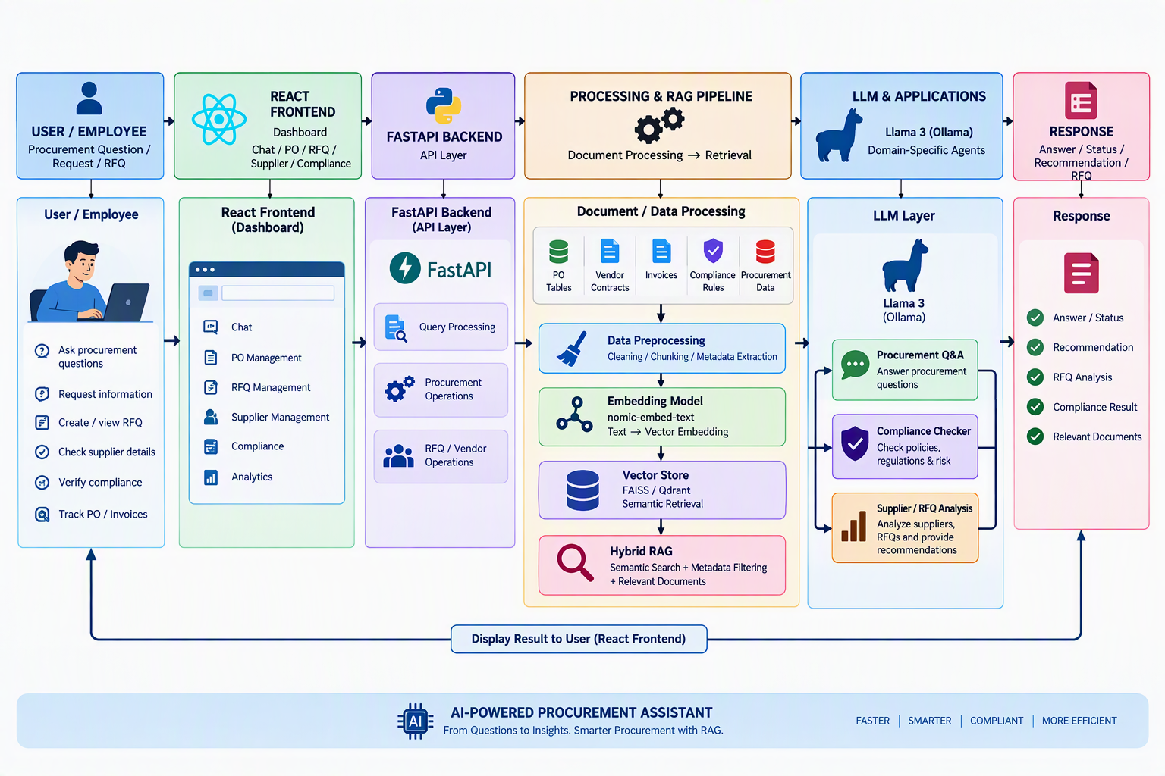
Project Title - Calibri body 18
Pipeline structure:
Calibri body 28

